Slide 1
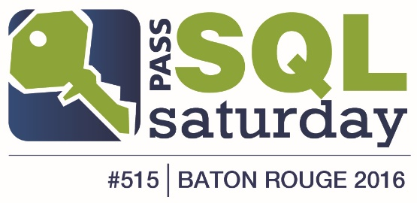
SQL Double Jeopardy!
DR
SSIS
SQL 2016
#SQLSatBR
$200
$200
$200
$200
$400
$400
$400
$400
$600
$600
$600
$600
$800
$800
$800
$800
$1000
$1000
$1000
$1000

Slide 4
Disaster Recovery - $200
In this recovery model, a SQL Server database will truncate transactions at a checkpoint, eliminating the possibility for transaction log backups or point-in-time recovery.
What is SIMPLE recovery mode?

Slide 5
Disaster Recovery - $400
This is the appropriate recovery model for databases that are temporary read-only copies or in pre-production environments.
What is the SIMPLE recovery model?

Slide 6
Disaster Recovery - $600
Of all SQL Server system databases, this is the only one that does not need to be backed up.
What is the tempdb?

Slide 7
Disaster Recovery - $800
In a database with all three types of basics SQL Server backups being taken regularly, this is the order in which they should be restored.
What is FULL, DIFFERENTIAL, and then TRANSACTION LOG backups?

Slide 8
Disaster Recovery - $1000
Now called AlwaysOn Availability Groups by the marketing folks, this was the original science-inspired codename for the feature.
What is HADRON? (High Availability, Disaster Recovery, ONline)

Slide 9
SSIS - $200
This version of SQL Server changed SSIS and made ETL developers very happy by removing configuration files and replacing them with the SSISDB and environment avriables.
What is SQL Server 2012?

Slide 10
SSIS - $400
This SSIS tool does nothing more than collect tasks into a precedence group, allowing groups of tasks to run together.
What is the sequence container?

Slide 11
SSIS - $600
This built-in SQL Server Agent Fixed database role in msdb grants members the ability to review operators, proxies and alerts, execute, stop or start all local jobs.
What is the SQLAgentOperatorRole?

Slide 12
SSIS - $800
Enable this on a Data Flow Path to see the actualy data rows while running the path in Visual Studio.
What is the data flow path Data Viewer?

Slide 13
SSIS - $1000
The Error data flow path of an OLE DB destination adds these two columns to the data path.
What are ErrorCode and ErrorColumn? (An ErrorDescription can also be retrieved with a subsequent Script Transformation task.)

Slide 14
SQL 2016 - $200
Also known as "system versioned tables", these objects will automatically track data changes with start and end date/times.
What are Temporal Tables?

Slide 15
SQL 2016 - $400
This new feature provides a separation between users who own the data and users who manage the data, because encryption/decryption occurs at the client layer.
What is Always Encrypted?

Slide 16


SQL 2016 - $600
Make your wager, up to $600 or your current winnings, at least $100. Only this player gets to wager.
Enabled by the "remote data archive" option using sp_configure, this new option allows you to store frequently accessed table data locally, while storing occasionally accessed table data in the cloud.
What is Stretch Database?

Slide 17
SQL 2016 - $800
This new feature maintains a history of query execution plans along with performance data, enabling users to quickly identify queries that have gotten slower/faster and respond accordingly.
What is the Query Store?

Slide 18
SQL 2016 - $1000
With the trend in recent years of using Web APIs, this new type was made a native datatype in SQL 2016, and has supporting capabilities similar to XML.
What is JSON?

Slide 19

SQLSaturday - $200
This percentage responded in a post-event survey that they would recommend SQLSaturday Baton Rouge to their technology peers.
What is 100%?
Notes:
Part I: how will we drive leads? How will we capture leads?

Slide 20
SQLSaturday - $400
SQLSaturday usually serves this for the free conference lunch.
What is Jambalaya?
Notes:
Part I: how will we drive leads? How will we capture leads?

Slide 21
SQLSaturday - $600
This is the only continent in the world that has yet to serve host to a PASS SQLSaturday event.
What is Antarctica?
Notes:
Part I: how will we drive leads? How will we capture leads?

Slide 22
SQLSaturday - $800
This facility has been the location for the last four annual SQLSaturday Baton Rouge events, sponsored by the LSU College of Business.
What is the LSU Business Education Complex?
Notes:
Part I: how will we drive leads? How will we capture leads?

Slide 23
SQLSaturday - $1000
In addition to Baton Rouge, this is the only other city in the world hosting a SQLSaturday even on August 6, 2016.
What is Louisville, Kentucky?
Notes:
Part I: how will we drive leads? How will we capture leads?

